Slide 1
Neural Network Accelerator on FPGA
Toms Jiji Varghese | Narayanan Nampoothiry | Sanidhya Saxena | Manish Singh

Slide 2


Introduction
Neural networks consists of an interconnected architecture of neurons
Neurons communicate with each other with varying strengths, to trigger certain actions
Inspired from the biological neural network, an Artificial Neural Network (ANN) is developed
ANN outperforms other topologies of circuit implementation in many applications. E.g.: Classification of objects

Slide 3

Background study

Slide 4
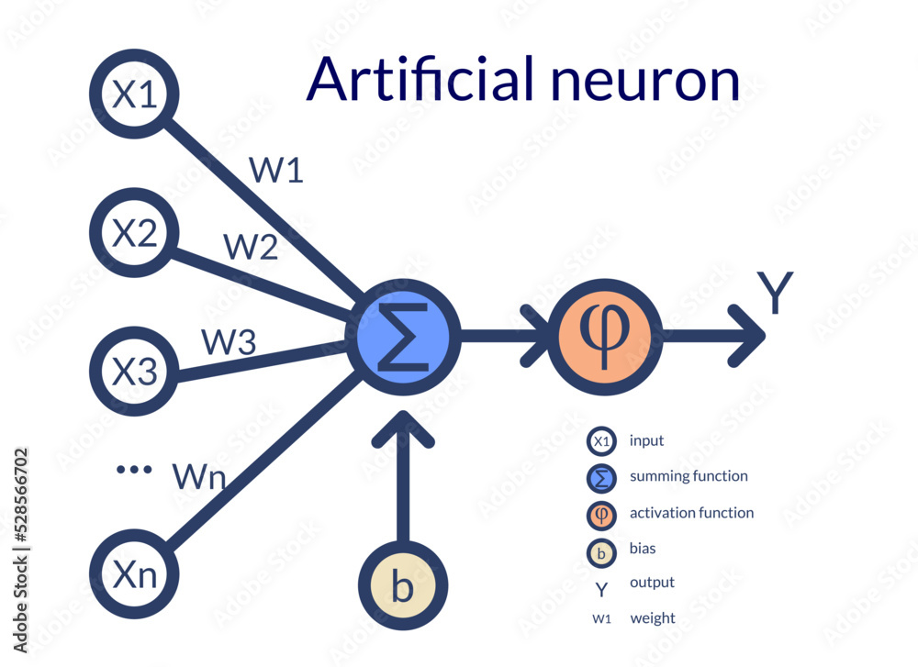
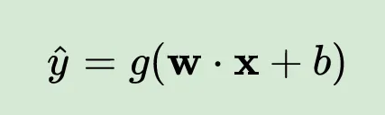
Perceptron
Fundamental element of an ANN
Referred as a node of the network
Carries out a MAC operation
Characterized by
Weights
Biases
Activation function

Slide 5

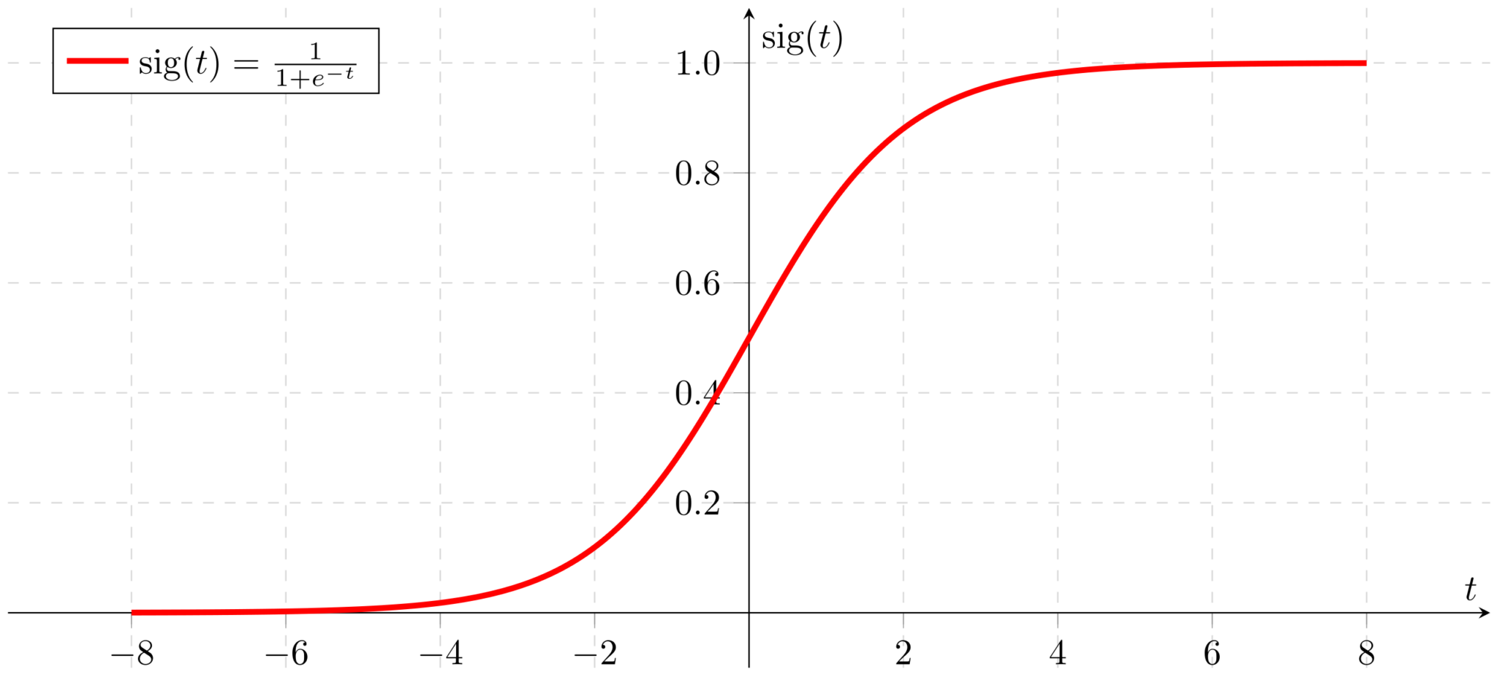
Activation functions

Slide 6
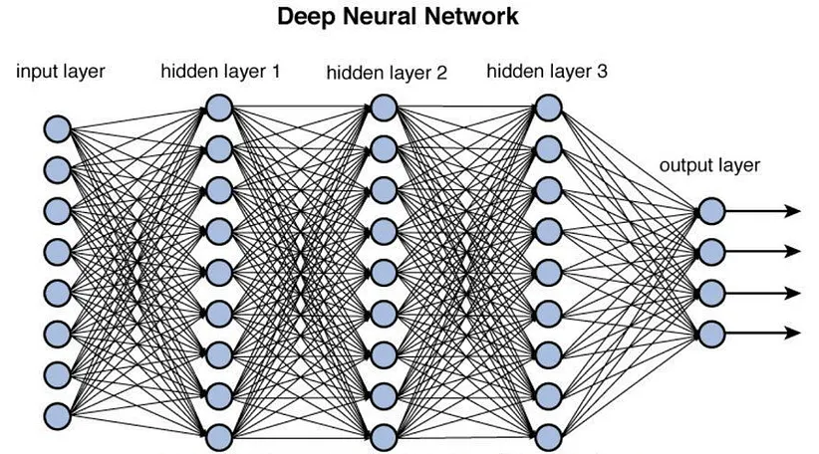
Deep neural networks
Perceptron form the fundamental element of a network
Receives input, multiply by weights, add bias and outputs through an activation function
Multiple perceptron on the same set of inputs form a layer
Input transformed to output through layers form a Neural network
Network with more than one intermediate layers (hidden layers) forms a Deep Neural Network

Slide 7
ARCHITECTURE

Slide 8
Block diagram
Memory
Pixel-1
Memory
interface
Image
Register
Input
Layer
HiddenLayer
1
HiddenLayer
2
HiddenLayer
3
Output Layer
Hard MAX
Pixel-2
.
.
.
Pixel-784
PC
Pixel-1
Pixel-2
UART
.
.
.
Pixel-784

Slide 9
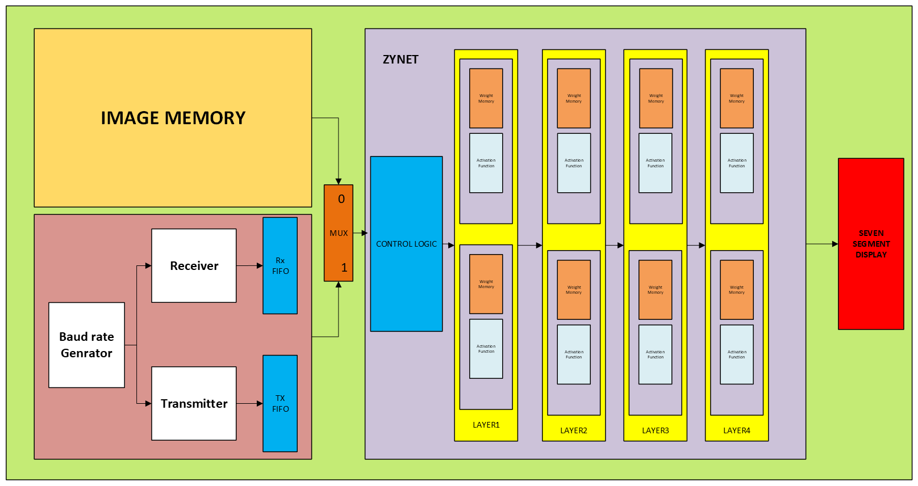
MICRO ARCHITECTURE

Slide 10
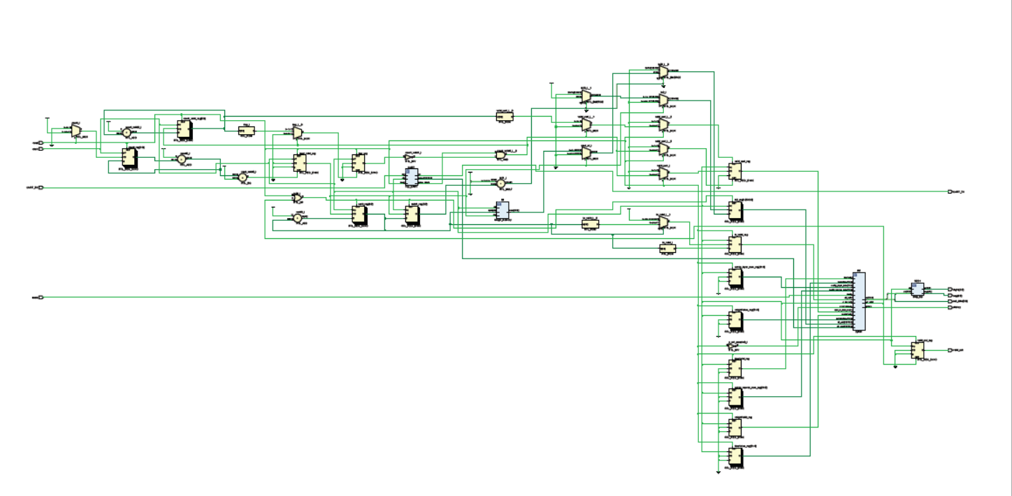
RTL Schematic

Slide 11
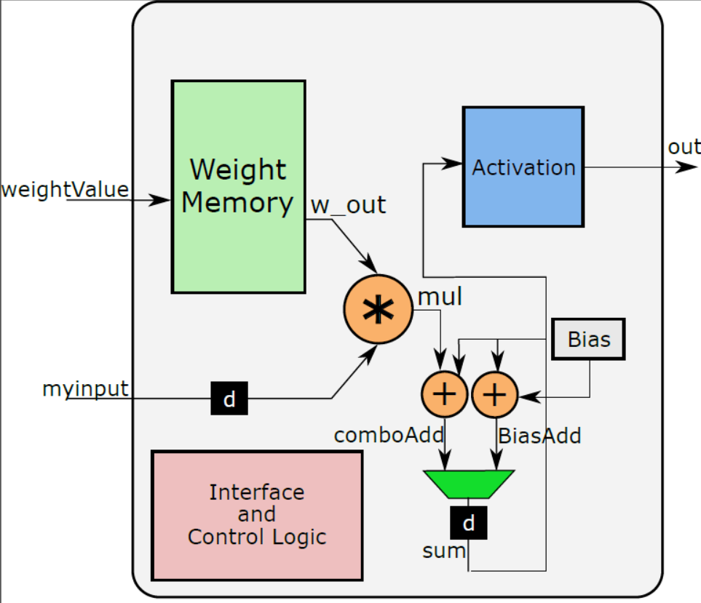
NEURON DESIGN
Fixed Point signed multiplication used for multiplying weights and inputs
Overflow and Underflow condition taken care
Weight Memory implemented in Block Ram
Activation function is parameterized and can be chosen from the top between sigmoid or Relu.
Sequential implementation is used for inputs to optimise resource utilisation.
Sigmoid function is implemented using Distributed RAM (LUT), but the size is small (64X32).

Slide 12
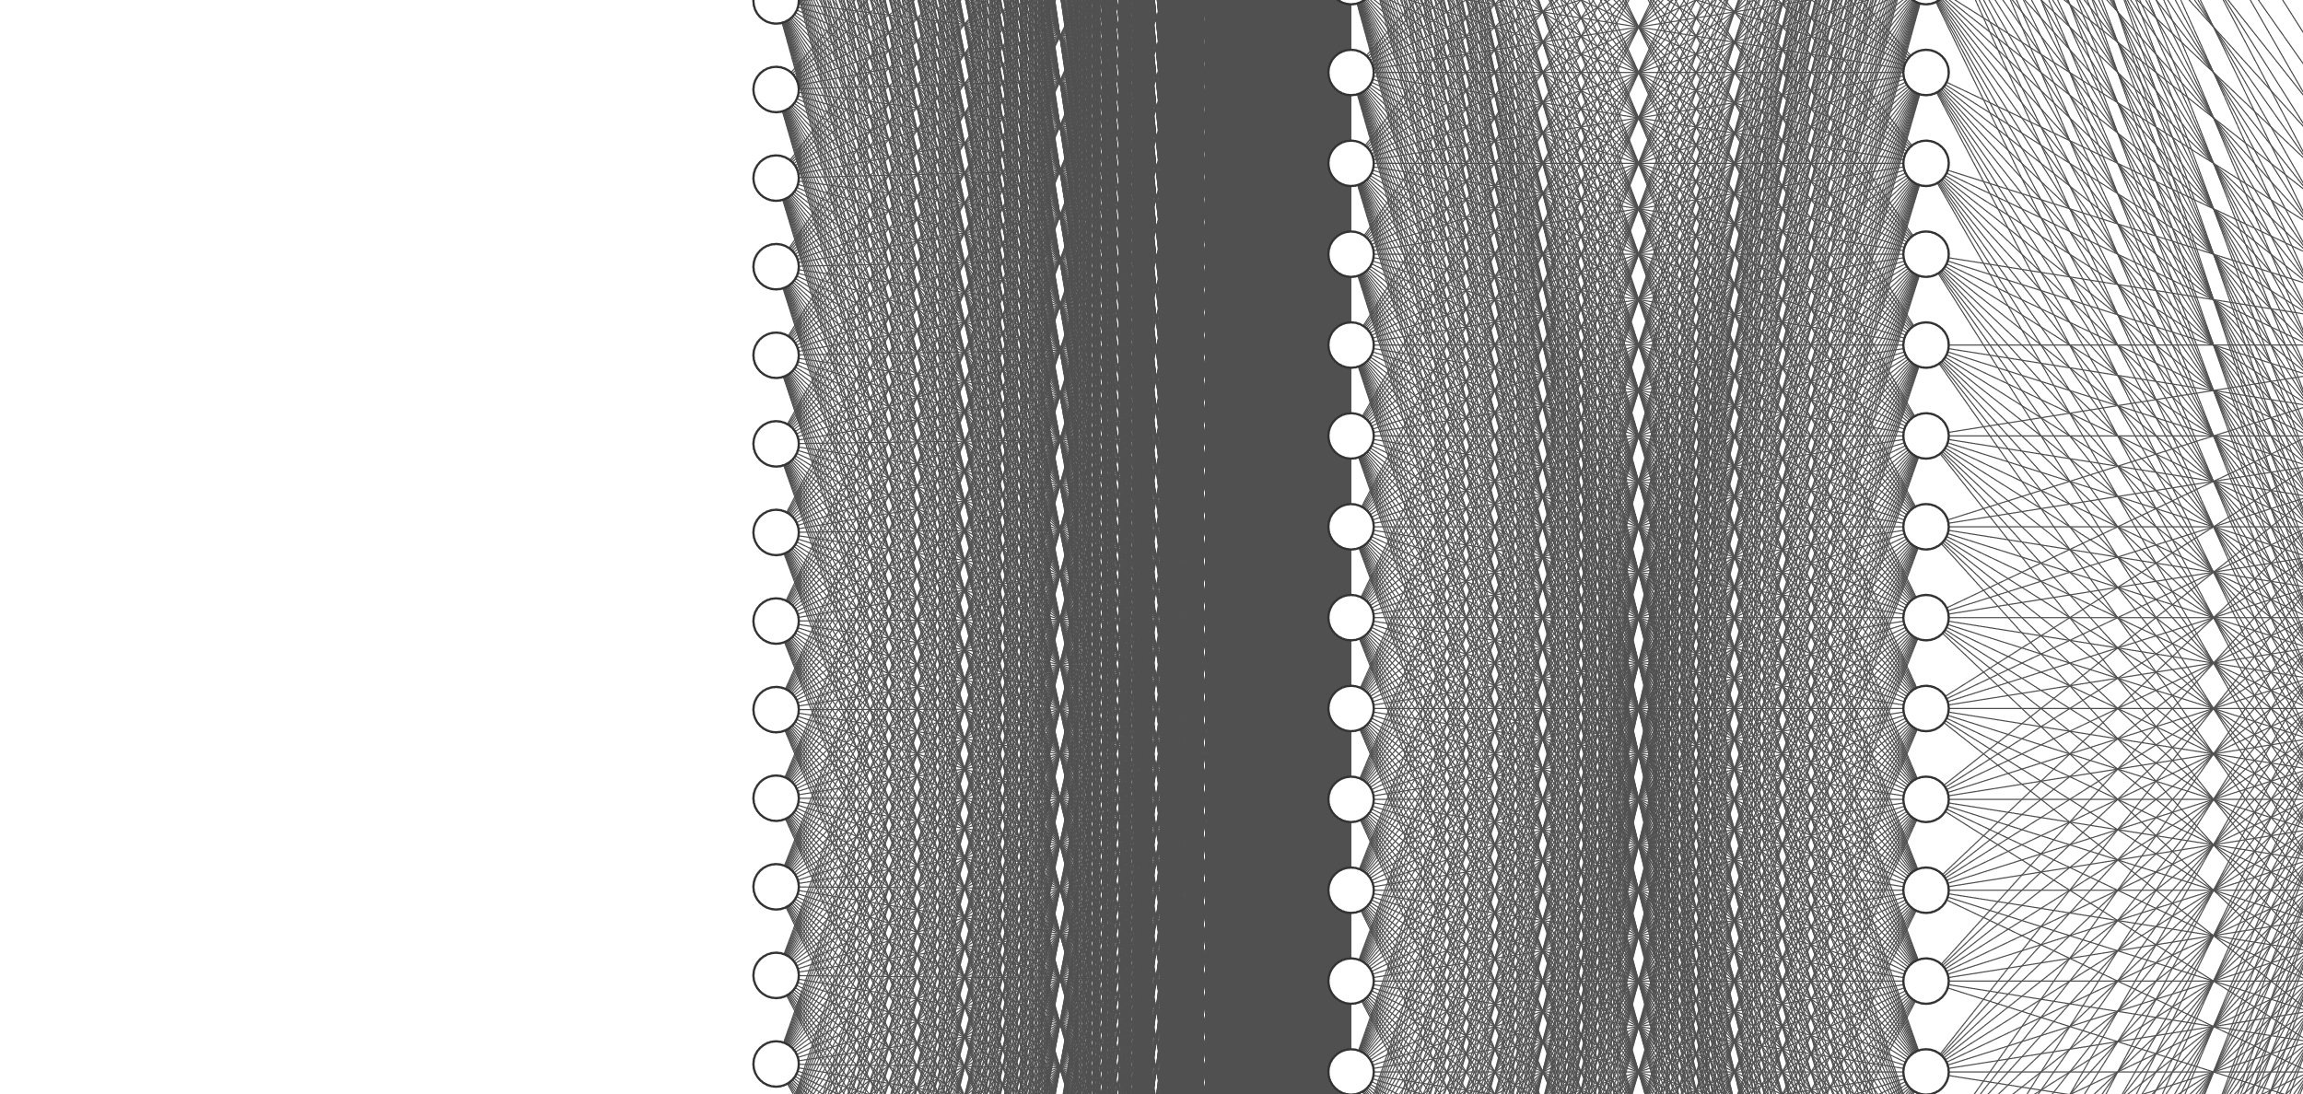
NEURON DESIGN
4 Layers of dense Neural network structure
Layer1-30 neuron Layer2-30 neuron Layer3-10 neuron Layer4-10 neuron
Input layer consist of 784 input pixel directly connected to layer1, feeding serially.
Output of every Layer is taken in parallel, and is given serially to next concurrent layer.
Valid control is used for data flow in the forward propogation.

Slide 13
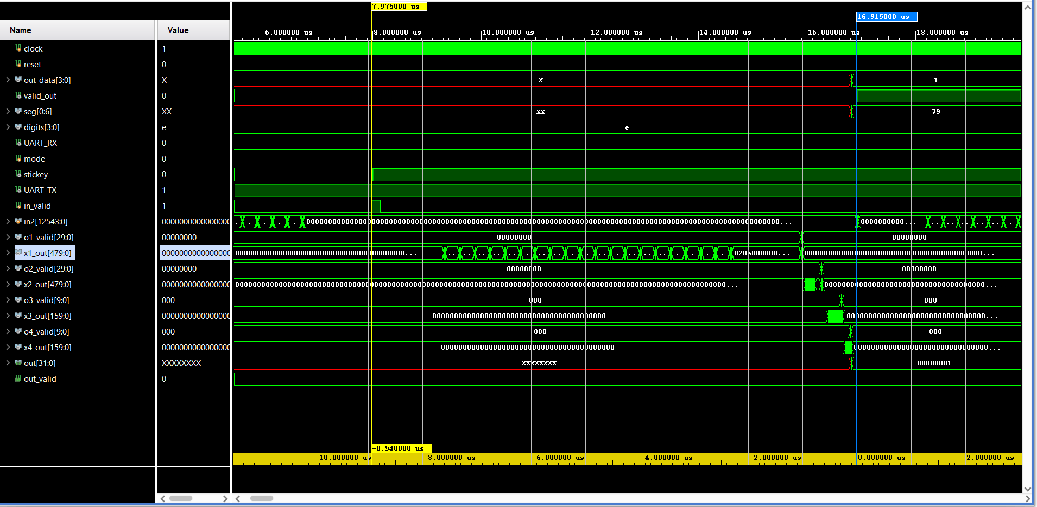
NEURON DESIGN

Slide 14
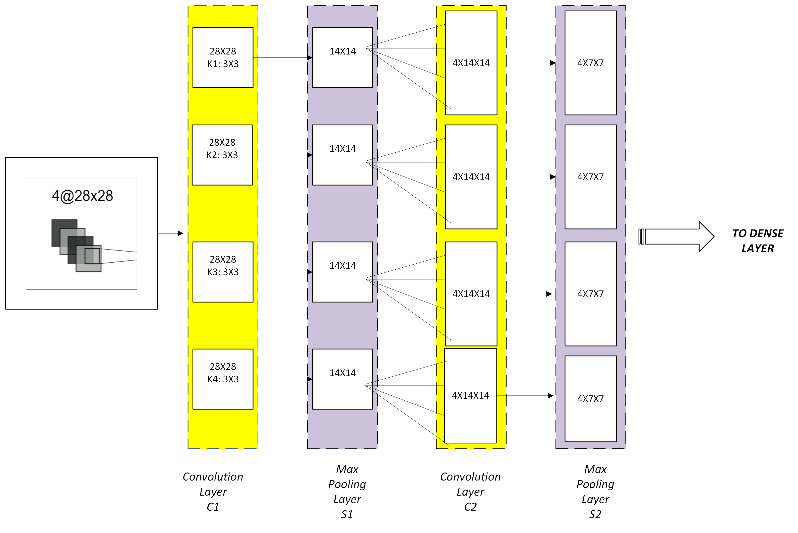
CNN EXPECTED ARCHITECTURE

Slide 15
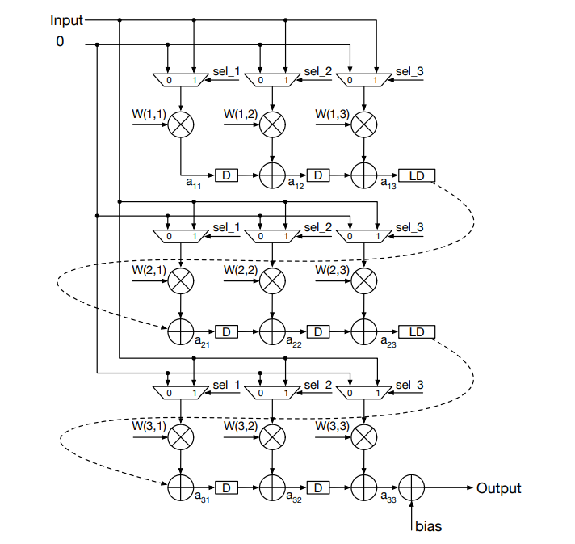
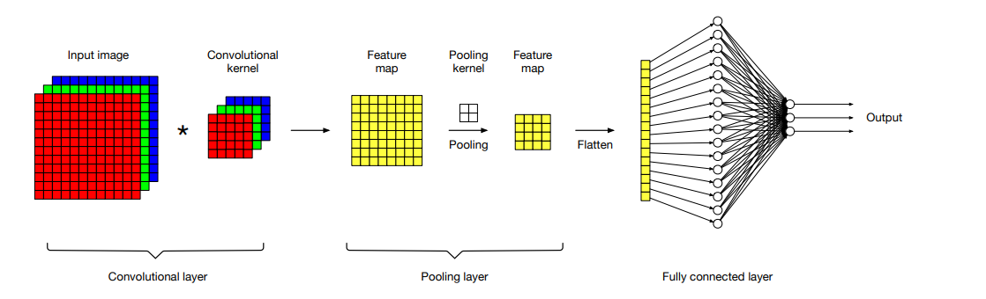
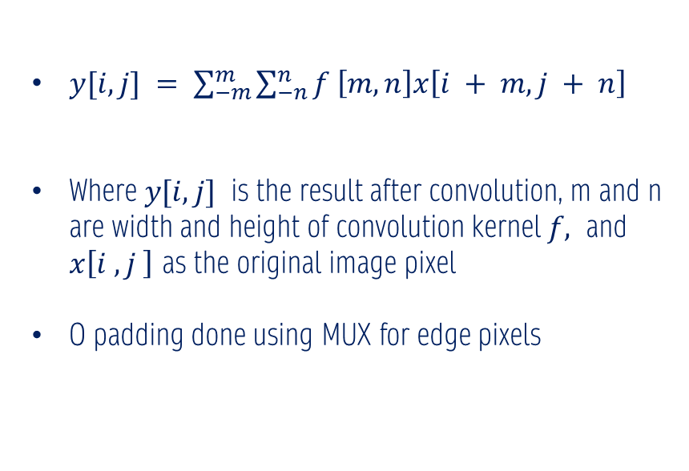
CONVOLUTION DESIGN
$y[i, j] = \sum_{−m}^{m}{\sum_{−n}^{n}{f \left[m, n\right]x\left[i + m, j + n\right]}}$
Where $y[i, j]$ is the result after convolution, m and n are width and height of convolution kernel $f,$ and $x\left[i , j \right]$ as the original image pixel
O padding done using MUX for edge pixels

Slide 16
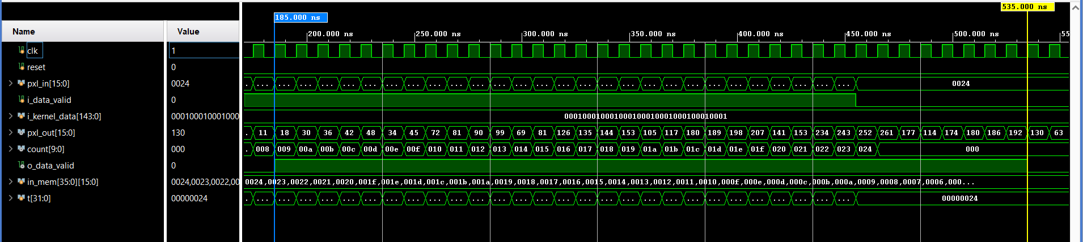
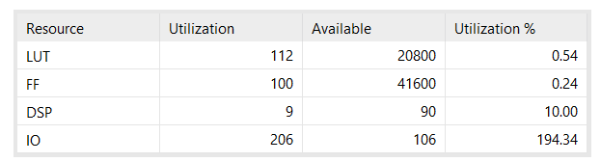
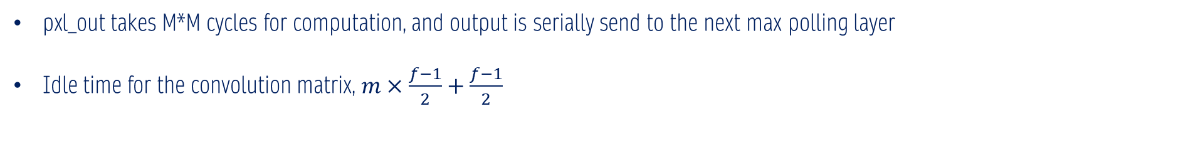
CONVOLUTION DESIGN
pxl_out takes M*M cycles for computation, and output is serially send to the next max polling layer
Idle time for the convolution matrix, $m×\frac{f−1}{2}+\frac{f−1}{2}$

Slide 17
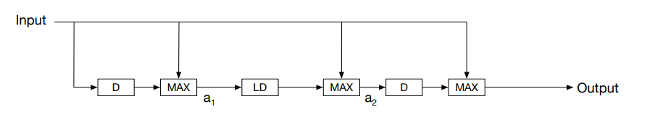
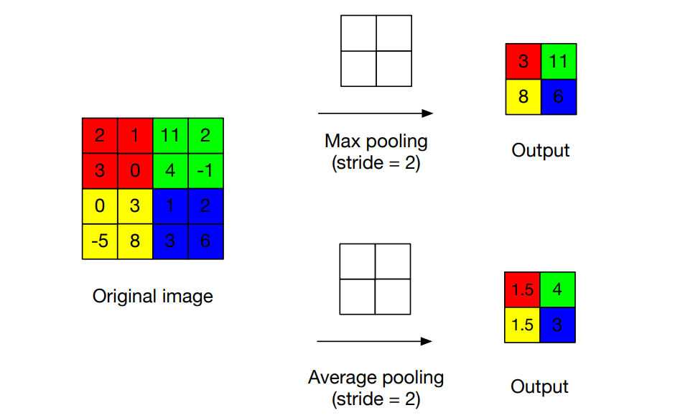
MAX POOLING DESIGN

Slide 18
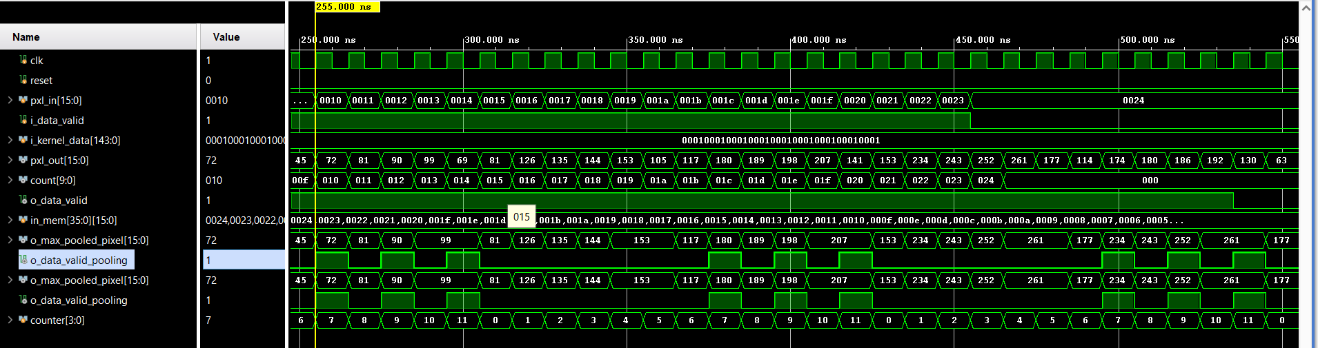
MAX POOLING DESIGN
Max Pooling layer takes M*M cycles for computation, and output is serially send to the next convolution layer but not in succession.
Since the pooling operation in S2 uses a stride of two pixels in both vertical and horizontal directions, we cannot get valid outputs every clock cycle.

Slide 19
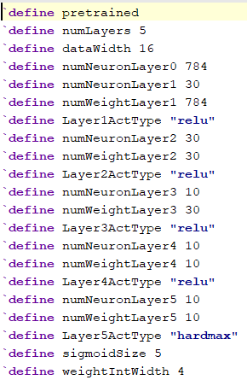
Architecture: Parameters of the Network

Slide 20
IMPLEMENTATION

Slide 21
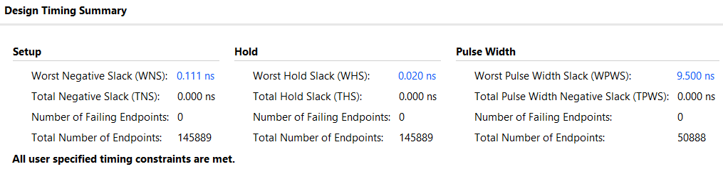
Timing summary

Slide 22
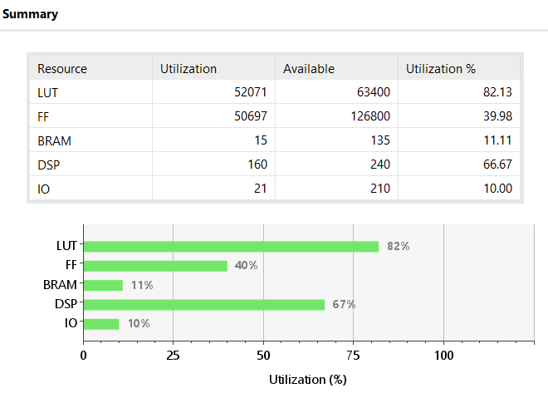
Resource utilization

Slide 23
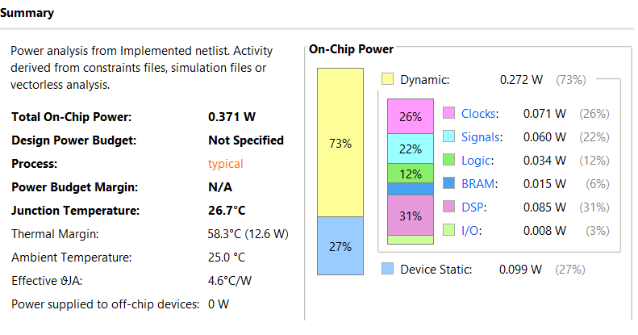
Power budget

Slide 24
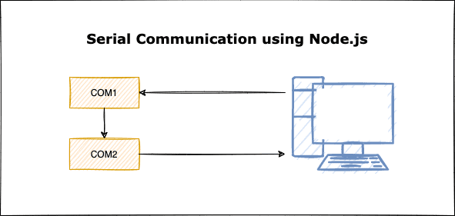
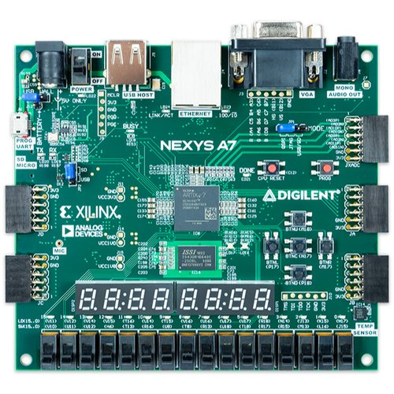
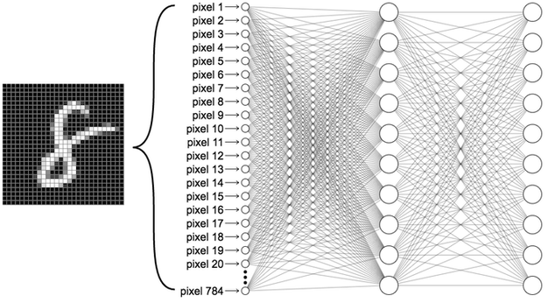
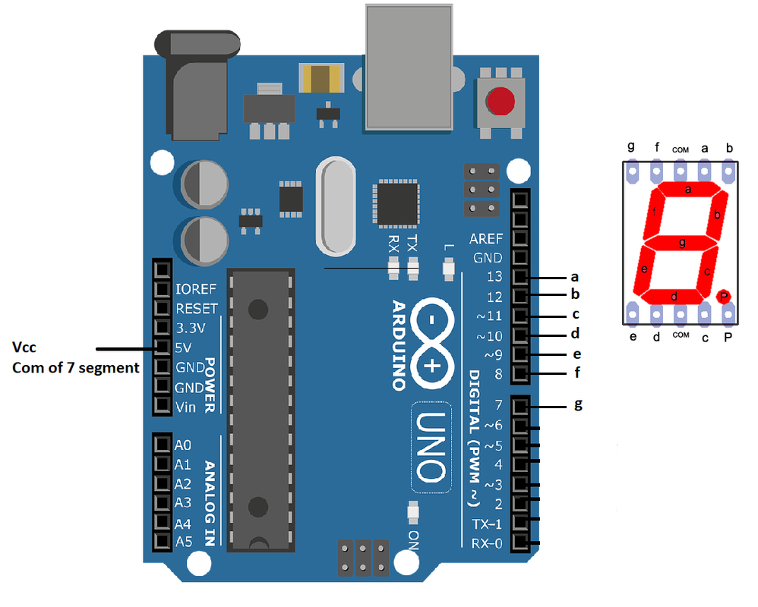
Testing
MATLAB
UART

Slide 25
Summary
A neural network accelerator that carries out digit recognition on NEXYS A7.
The accuracy was proven on the simulation and found to be 91% with RELU and 98% with Sigmoid activation functions
Inferences done on the FPGA yielded correct results.

Slide 26

Thank you

